Slide 1
Sorting
Prepared by: Afaq Mansoor Khan
BSSE III- Group A
Session 2017-21
IMSciences, Peshawar.

Slide 2
Last Lecture Summary
Recursion and Types, Space and Time Complexity
Introduction to Sorting Algorithms
Bubble Sort Algorithm, Algorithm Analysis

Slide 3
Objectives Overview
Selection Sort,
Insertion Sort,
Algorithms Analysis
Merge Sort Algorithm,
Merge Sort Analysis

Slide 4
Selection Sort

Slide 5
Selection Sort
It is specifically an in-place comparison sort
Noted for its simplicity,
It has performance advantages over more complicated algorithms in certain situations, particularly where auxiliary memory is limited
The algorithm
finds the minimum value,
swaps it with the value in the first position, and
repeats these steps for the remainder of the list
It does no more than n swaps, and thus is useful where swapping is very expensive

Slide 6
Sorting an Array of Integers
The picture shows an array of six integers that we want to sort from smallest to largest
[0] [1] [2] [3] [4] [5]
Notes:
The picture shows a graphical representation of an array which we will sort so that the smallest element ends up at the front, and the other elements increase to the largest at the end. The bar graph indicates the values which are in the array before sorting--for example the first element of the array contains the integer 45.

Slide 7
The Selection Sort Algorithm
Start by finding the smallest entry.
[0] [1] [2] [3] [4] [5]
Notes:
The first sorting algorithm that we'll examine is called Selectionsort. It begins by going through the entire array and finding the smallest element. In this example, the smallest element is the number 8 at location [4] of the array.

Slide 8
Start by finding the smallest entry.
Swap the smallest entry with the first entry.
[0] [1] [2] [3] [4] [5]
Notes:
Once we have found the smallest element, that element is swapped with the first element of the array...

Slide 9
Start by finding the smallest entry.
Swap the smallest entry with the first entry.
[0] [1] [2] [3] [4] [5]
Notes:
...like this.
The smallest element is now at the front of the array, and we have taken one small step toward producing a sorted array.

Slide 10
Sorted side
Unsorted side
Part of the array is now sorted.
[0] [1] [2] [3] [4] [5]
Notes:
At this point, we can view the array as being split into two sides: To the left of the dotted line is the "sorted side", and to the right of the dotted line is the "unsorted side". Our goal is to push the dotted line forward, increasing the number of elements in the sorted side, until the entire array is sorted.

Slide 11
Sorted side
Unsorted side
Find the smallest element in the unsorted side.
[0] [1] [2] [3] [4] [5]
Notes:
Each step of the Selectionsort works by finding the smallest element in the unsorted side. At this point, we would find the number 15 at location [5] in the unsorted side.

Slide 12
Sorted side
Unsorted side
Find the smallest element in the unsorted side.
Swap with the front of the unsorted side.
[0] [1] [2] [3] [4] [5]
Notes:
This small element is swapped with the number at the front of the unsorted side, as shown here...

Slide 13
Sorted side
Unsorted side
We have increased the size of the sorted side by one element.
[0] [1] [2] [3] [4] [5]
Notes:
...and the effect is to increase the size of the sorted side by one element.
As you can see, the sorted side always contains the smallest numbers, and those numbers are sorted from small to large. The unsorted side contains the rest of the numbers, and those numbers are in no particular order.

Slide 14
Sorted side
Unsorted side
Smallest
from
unsorted
The process continues...
[0] [1] [2] [3] [4] [5]
Notes:
Again, we find the smallest entry in the unsorted side...

Slide 15
Sorted side
Unsorted side
The process continues...
Swap
with
front
[0] [1] [2] [3] [4] [5]
Notes:
...and swap this element with the front of the unsorted side.

Slide 16
Sorted side
is bigger
Sorted side
Unsorted side
The process continues...
[0] [1] [2] [3] [4] [5]
Notes:
The sorted side now contains the three smallest elements of the array.

Slide 17
The process keeps adding one more number to the sorted side.
The sorted side has the smallest numbers, arranged from small to large.
Sorted side
Unsorted side
[0] [1] [2] [3] [4] [5]
Notes:
Here is the array after increasing the sorted side to four elements.

Slide 18
We can stop when the unsorted side has just one number, since that number must be the largest number.
Sorted side
Unsorted side
[0] [1] [2] [3] [4] [5]
Notes:
And now the sorted side has five elements.
In fact, once the unsorted side is down to a single element, the sort is completed. At this point the 5 smallest elements are in the sorted side, and so the the one largest element is left in the unsorted side.
We are done...

Slide 19
The Selection Sort Algorithm
The array is now sorted.
We repeatedly selected the smallest element, and moved this element to the front of the unsorted side.
[0] [1] [2] [3] [4] [5]
Notes:
...The array is sorted.
The basic algorithm is easy to state and also easy to program.

Slide 20
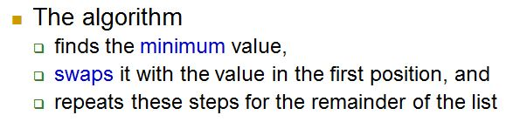
Selection Sort – Algorithm

Slide 21
Selection Sort – Pseudocode
Input: An array A[1..n] of n elements.
Output: A[1..n] sorted in descending order
1. for i ← 1 to n - 1
2. min ← i
3. for j ← i + 1 to n {Find the i th smallest element.}
4. if A[j] < A[min] then
5. min ← j
6. end for
7. if min ≠ i then interchange A[i] and A[min]
8. end for

Slide 22
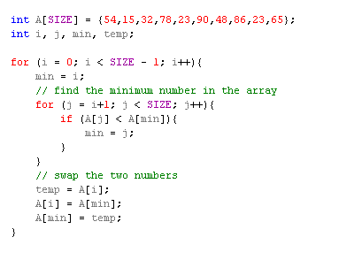
Selection Sort – Implementation

Slide 23
Complexity of Selection Sort
An in-place comparison sort
O(n²) complexity, making it inefficient on large lists, and generally performs worse than the similar insertion sort.
Selection sort is not difficult to analyze compared to other sorting algorithms since none of the loops depend on the data in the array

Slide 24
Complexity of Selection Sort
Selecting the lowest element requires scanning all n elements (this takes n − 1 comparisons) and then swapping it into the first position
Finding the next lowest element requires scanning the remaining n − 1 elements and so on,
for (n − 1) + (n − 2) + ... + 2 + 1 = n(n − 1) / 2 ∈ O(n²) comparisons
Each of these scans requires one swap for n − 1 elements (the final element is already in place).

Slide 25
Complexity of Selection Sort
Worst case performance
Best case performance
Average case performance
Worst case space complexity Total:
Worst case space complexity auxiliary:
Where n is the number of elements being sorted
25

Slide 26
Insertion Sort

Slide 27
Insertion Sort
Insertion sort is not as slow as bubble sort, and it is easy to understand.
Insertion sort keeps making the left side of the array sorted until the whole array is sorted.
Real life example:
Insertion sort works the same way as arranging your hand when playing cards.
To sort the cards in your hand you extract a card, shift the remaining cards, and then insert the extracted card in the correct place.

Slide 28
The Insertion Sort Algorithm
Views the array as having two sides
a sorted side and
an unsorted side.
[0] [1] [2] [3] [4] [5]
Notes:
Now we'll look at another sorting method called Insertionsort. The end result will be the same: The array will be sorted from smallest to largest. But the sorting method is different.
However, there are some common features. As with the Selectionsort, the Insertionsort algorithm also views the array as having a sorted side and an unsorted side, ...

Slide 29
Sorted side
Unsorted side
The sorted side starts with just the first element, which is not necessarily the smallest element.
[0] [1] [2] [3] [4] [5]
Notes:
...like this.
However, in the Selectionsort, the sorted side always contained the smallest elements of the array. In the Insertionsort, the sorted side will be sorted from small to large, but the elements in the sorted side will not necessarily be the smallest entries of the array.
Because the sorted side does not need to have the smallest entries, we can start by placing one element in the sorted side--we don't need to worry about sorting just one element. But we do need to worry about how to increase the number of elements that are in the sorted side.

Slide 30
Sorted side
Unsorted side
The sorted side grows by taking the front element from the unsorted side...
[0] [1] [2] [3] [4] [5]
Notes:
The basic approach is to take the front element from the unsorted side...

Slide 31
Sorted side
Unsorted side
...and inserting it in the place that keeps the sorted side arranged from small to large.
[0] [1] [2] [3] [4] [5]
Notes:
...and insert this element at the correct spot of the sorted side.
In this example, the front element of the unsorted side is 20. So the 20 must be inserted before the number 45 which is already in the sorted side.

Slide 32
In this example, the new element goes in front of the element that was already in the sorted side.
Sorted side
Unsorted side
[0] [1] [2] [3] [4] [5]
Notes:
After the insertion, the sorted side contains two elements. These two elements are in order from small to large, although they are not the smallest elements in the array.

Slide 33
Sometimes we are lucky and the new inserted item doesn't need to move at all.
Sorted side
Unsorted side
[0] [1] [2] [3] [4] [5]
Notes:
Sometimes we are lucky and the newly inserted element is already in the right spot. This happens if the new element is larger than anything that's already in the array.

Slide 34
Sorted side
Unsorted side
Sometimes we are lucky twice in a row.
[0] [1] [2] [3] [4] [5]
Notes:
Sometimes we are lucky twice in a row.

Slide 35
Copy the new element to a separate location.
Sorted side
Unsorted side
[0] [1] [2] [3] [4] [5]
Notes:
The actual insertion process requires a bit of work that is shown here. The first step of the insertion is to make a copy of the new element. Usually this copy is stored in a local variable. It just sits off to the side, ready for us to use whenever we need it.

Slide 36
Shift elements in the sorted side, creating an open space for the new element.
[0] [1] [2] [3] [4] [5]
Notes:
After we have safely made a copy of the new element, we start shifting elements from the end of the sorted side. These elements are shifted rightward, to create an "empty spot" for our new element to be placed.
In this example we take the last element of the sorted side and shift it rightward one spot...

Slide 37
Shift elements in the sorted side, creating an open space for the new element.
[0] [1] [2] [3] [4] [5]
Notes:
...like this.
Is this the correct spot for the new element? No, because the new element is smaller than the next element in the sorted section. So we continue shifting elements rightward...

Slide 38
Continue shifting elements...
[0] [1] [2] [3] [4] [5]
Notes:
This is still not the correct spot for our new element, so we shift again...

Slide 39
Continue shifting elements...
[0] [1] [2] [3] [4] [5]
Notes:
...and shift one more time...

Slide 40
...until you reach the location for the new element.
[0] [1] [2] [3] [4] [5]
Notes:
Finally, this is the correct location for the new element. In general there are two situations that indicate the "correct location" has been found:
1. We reach the front of the array (as happened here), or
2. We reached an element that is less than or equal to the new element.

Slide 41
Copy the new element back into the array, at the correct location.
Sorted side
Unsorted side
[0] [1] [2] [3] [4] [5]
Notes:
Once the correct spot is found, we copy the new element back into the array. The number of elements in the sorted side has increased by one.

Slide 42
The last element must also be inserted. Start by copying it...
Sorted side
Unsorted side
[0] [1] [2] [3] [4] [5]
Notes:
The last element of the array also needs to be inserted. Start by copying it to a safe location.

Slide 43
How many shifts will occur before we copy this element back into the array?
[0] [1] [2] [3] [4] [5]
Notes:
Now we will shift elements rightward. How many shifts will be done?

Slide 44
Four items are shifted.
[0] [1] [2] [3] [4] [5]
Notes:
These four elements are shifted. But the 7 at location [0] is not shifted since it is smaller than the new element.

Slide 45
The Insertion Sort Algorithm
Four items are shifted.
And then the element is copied back into the array.
[0] [1] [2] [3] [4] [5]
Notes:
The new element is inserted into the array.

Slide 46
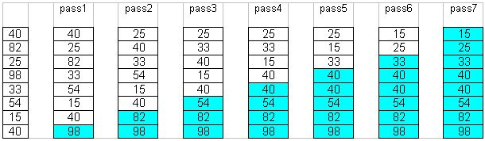
Insertion Sort Example
To sort an array with k elements, Insertion sort requires k – 1 passes.
Example:

Slide 47
Insertion Sort - Algorithm
For i = 2 to n do the following
a. set NextElement = x[i] and x[0] = nextElement b. set j = i c. While nextElement < x[j – 1] do following set x[j] equal to x[j – 1] decrement j by 1 End wile
d. set x[j] equal to nextElement
End for

Slide 48
Insertion Sort - Pseudocode
Input: An array A[1..n] of n elements.
Output: A[1..n] sorted in nondecreasing order.
1. for i ← 2 to n
2. x ← A[i]
3. j ← i - 1
4. while (j >0) and (A[j] > x)
5. A[j + 1] ← A[j]
6. j ← j - 1
7. end while
8. A[j + 1] ← x
9. end for

Slide 49
Insertion Sort - Implementation
void InsertionSort(int s1[], int size){ int i,j,k,temp;
for(i=1;i < size;i++) {
temp=s1[i]; j=i;
while((j > 0)&&(temp < s1[j-1]) { s1[j]=s1[j-1];
j=j-1; } // end of while loop s1[j]=temp; } // end of for loop
} // end of function

Slide 50
Complexity of Insertion Sort
Let a0, ..., an-1 be the sequence to be sorted. At the beginning and after each iteration of the algorithm the sequence consists of two parts: the first part a0, ..., ai-1 is already sorted, the second part ai, ..., an-1 is still unsorted (i in 0, ..., n).
The worst case occurs when in every step the proper position for the element that is inserted is found at the beginning of the sorted part of the sequence.

Slide 51
Complexity of Insertion Sort
The minimum # of element comparisons (best case) occurs when the array is already sorted in nondecreasing order. In this case, the # of element comparisons is exactly n - 1, as each element A[i], 2 ≤ i ≤ n, is compared with A[i - 1] only.
The maximum # of element comparisons (Worst case) occurs if the array is already sorted in decreasing order and all elements are distinct. In this case, the number is
n n-1
∑ (i – 1) = ∑ (i – 1) = n(n-1)/2
i =2 i =1
This is because each element A[i], 2 ≤ i ≤ n is
compared with each entry in subarray A[1 .. i-1]
➔ Pros: Relatively simple and easy to implement. Cons: Inefficient for large lists.

Slide 52
Complexity of Insertion Sort
In the insertion sort algorithm (n – 1) times the loop will execute for comparisons and interchanging the numbers
The inner while loop iterates maximum of ((n – 1) × (n – 1))/2 times to compute the sorting
Best Case
occurs when the array A is in sorted order and the outer for loop will iterate for (n – 1) times
And the inner while loop will not execute because the given array is a sorted array
i.e. f(n)=O(n)

Slide 53
Complexity of Insertion Sort
Average Case
On the average case there will be approximately (n – 1)/2 comparisons in the inner while loop
Hence the average case
f (n) = (n – 1)/2 + ...... + 2/2 +1/2
= n (n – 1)/4
= O(n²)
Worst Case
The worst case occurs when the array A is in reverse order and the inner while loop must use the maximum number (n – 1) of comparisons
f(n) = (n – 1) + ....... 2 + 1
= (n (n – 1))/2
= O(n²)

Slide 54
Complexity of Insertion Sort
Best case: O(n). It occurs when the data is in sorted order. After making one pass through the data and making no insertions, insertion sort exits.
Average case: θ(n²) since there is a wide variation with the running time.
Worst case: O(n²) if the numbers were sorted in reverse order.

Slide 55
Complexity of Insertion Sort
Best case performance
Average case performance
Worst case performance
Worst case space complexity auxiliary
Where n is the number of elements being sorted
≈ n²/2 comparisons and exchanges
55

Slide 56
Comparison Bubble and Insertion Sort
Bubble sort is asymptotically equivalent in running time O(n²) to insertion sort in the worst case
But the two algorithms differ greatly in the number of swaps necessary
Experimental results have also shown that insertion sort performs considerably better even on random lists.
For these reasons many modern algorithm textbooks avoid using the bubble sort algorithm in favor of insertion sort.

Slide 57
Comparison Bubble and Insertion Sort
Bubble sort also interacts poorly with modern CPU hardware. It requires
at least twice as many writes as insertion sort,
twice as many cache misses, and
asymptotically more branch mispredictions.
Experiments of sorting strings in Java show bubble sort to be
roughly 5 times slower than insertion sort and
40% slower than selection sort

Slide 58
Comparison of Sorts
 | Bubble | Selection | Insertion
Best Case
Average Case
Worst Case
Space complexity

Slide 59
Merge Sort

Slide 60
Merge Sort
Like QuickSort, Merge Sort is a Divide and Conquer algorithm. It divides input array in two halves, calls itself for the two halves and then merges the two sorted halves. The merge() function is used for merging two halves. The merge(arr, l, m, r) is key process that assumes that arr[l..m] and arr[m+1..r] are sorted and merges the two sorted sub-arrays into one.

Slide 61
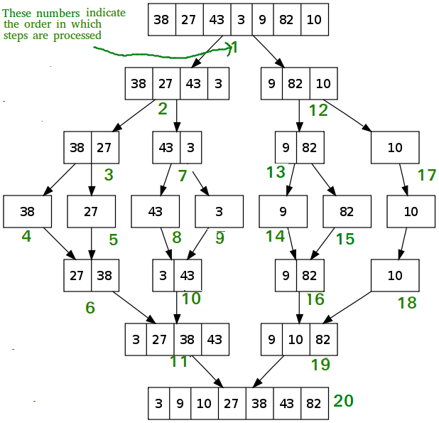
Merge Sort Algorithm

Slide 62
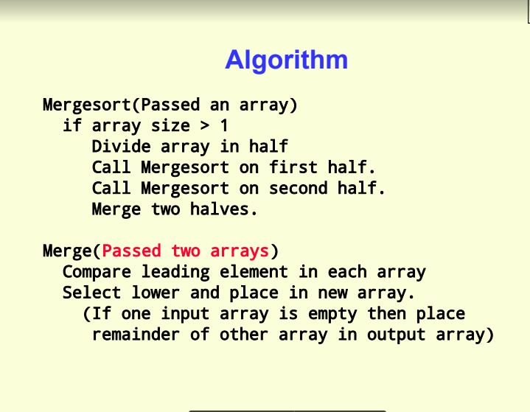

Slide 63
Merge Sort - Implementation
void MergeSort(int LIST[], int lo, int hi)
{
int mid;
if(lo < hi)
{
mid = (lo + hi)/ 2;
MergeSort(LIST, lo, mid);
MergeSort(LIST, mid+1, hi);
ListMerger(LIST, lo, mid, hi);
}
}
void ListMerger(int List[], int lo, int mid, int hi)
{
int TempList[hi-lo+1]; //temporary merger array
int i = lo, j = mid + 1; //i is for left-hand,j is for right-hand
int k = 0; //k is for the temporary array
while(i <= mid && j <=hi)
{
if(List[i] <= List[j])
TempList[k++] = List[i++];
else
TempList[k++] = List[j++];
}

Slide 64
Merge Sort - Implementation
//remaining elements of left-half
while(i <= mid)
TempList[k++] = List[i++];
//remaining elements of right-half
while(j <= hi)
TempList[k++] = List[j++];
//copy the mergered temporary List to the original List
for(k = 0, i = lo; i <= hi; ++i, ++k)
List[i] = TempList[k];
}

Slide 65
Performance
Time Complexity: Sorting arrays on different machines. Merge Sort is a recursive algorithm and time complexity can be expressed as following recurrence relation. T(n) = 2T(n/2) + O(n) The above recurrence can be solved either using Recurrence Tree method or Master method. It falls in case II of Master Method and solution of the recurrence is O(nlogn). Time complexity of Merge Sort is O(nlogn) in all 3 cases (worst, average and best) as merge sort always divides the array in two halves and take linear time to merge two halves.

Slide 66
Performance
Auxiliary Space: O(n)
Algorithmic Paradigm: Divide and Conquer
Sorting In Place: No in a typical implementation
Stable: Yes

Slide 67
Summary
Selection Sort,
Insertion Sort,
Algorithms Analysis
Merge Sort Algorithm,
Merge Sort Analysis

Slide 68
References
https://www.geeksforgeeks.org/sorting-algorithms/
https://brilliant.org/wiki/sorting-algorithms/
https://betterexplained.com/articles/sorting-algorithms/
https://codeburst.io/algorithms-i-searching-and-sorting-algorithms-56497dbaef20

